Slide 1
June 2017 – Monthly Training 5 ways to leverage your facebook live videos as a VA

Slide 2
Have you done one yet?
Who is a Smart Phone User? (Apple or Android)
Who is a Google Chrome User?

Slide 3
The How!

Slide 4
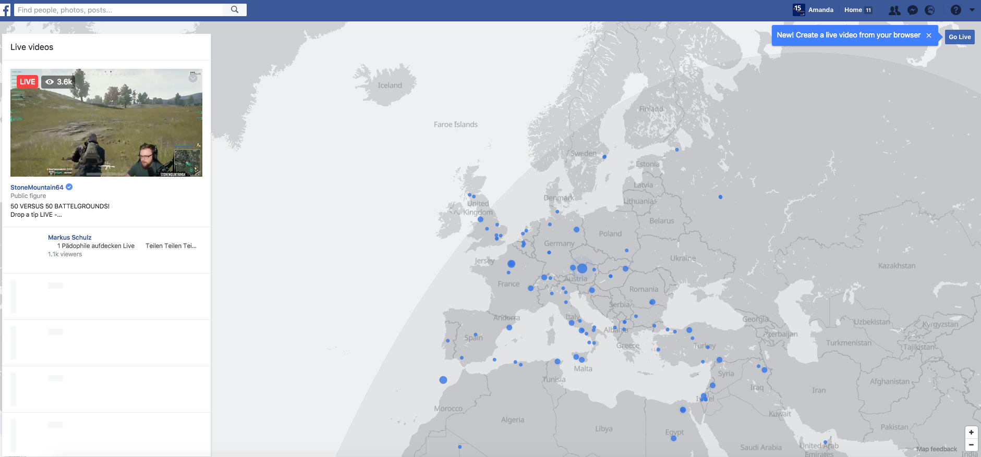
Facebook Live Map
https://www.facebook.com/livemap/

Slide 6
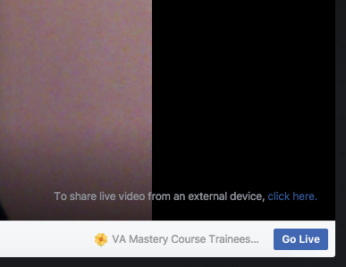
Simple and Easy to do
Press the blue “Go Live” button in the map’s top-right corner.
Follow the instructions re checking into your current location if you need to: Then enter a short, carefully-planned description using your best keyword, and select the audience
Press “Next”

Slide 7
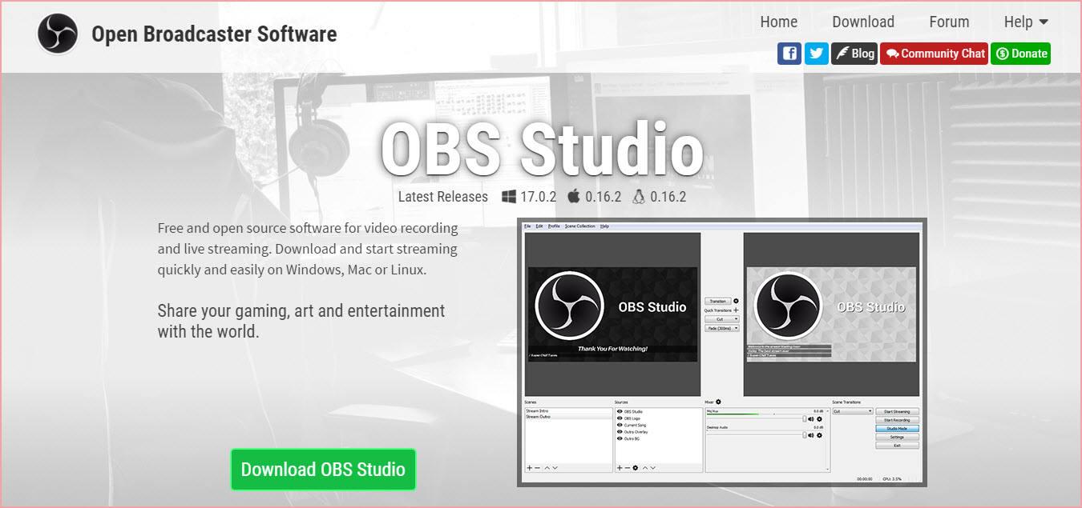
Getting Techie!
If you prefer to control your own recording options, you can also install and use broadcasting software such as OBS Studio, which is open-source video recording and live-streaming software free for anyone to download.

Slide 8
Why do it?
Create stronger relationship with your followers
Attract organic Facebook Live fans desperate for Live streaming– widens reach
Share insider tips with Facebook Group members
Satisfy Facebook users’ need for interaction, connection and immediate gratification
Build powerful links by leading people to your website—and to your landing pages

Slide 9
The Why - 9 Objectives of Social Media
Sell more products or services
Building your list
Growing connections and building relationships
Positioning yourself as the expert
Increasing your visibility
More traffic to the site
Provide better customer service
Reputation Management
Creating a movement

Slide 10
Why do it? Cont’d
Expand your community faster than you would expand by most traditional methods
Increase your credibility and authority almost instantly. The interactive, live excitement factor and the fact that you can respond immediately to comments from your viewers
Go through them later for product, teaching, book and blog post ideas
For your clients – if they have Facebook Groups – it allows members to be part of their life.

Slide 11
What to talk about?
Doesn’t have to be scripted
Think of the pain points of your clients – solve them
Talk about services you deliver
Build relationships
Create a template of what you want to cover

Slide 12
My Facebook Live Template
Todays Thought/Problem:
My question to my Viewers:
Invitation to share their thoughts or ask questions:
My personal example of this point or situation:
My comments on their comments or questions:
My solution / summary:
Call to action I want to end with:

Slide 13
Leverage of Facebook Lives

Slide 14
Step one: post your facebook live videos to youtube

Slide 15
Post Your Facebook Live Videos to YouTube
Upload Facebook Live videos to YouTube from your Page or Group. Use optimized descriptions and keywords to attract the right audience and ensure more shares.
Uploading to YouTube is a simple, 3-step process:
Download in HD from FB video
Right-click on live video you want to upload to YouTube
Select "Save video/file as..." and select “YouTube”

Slide 16
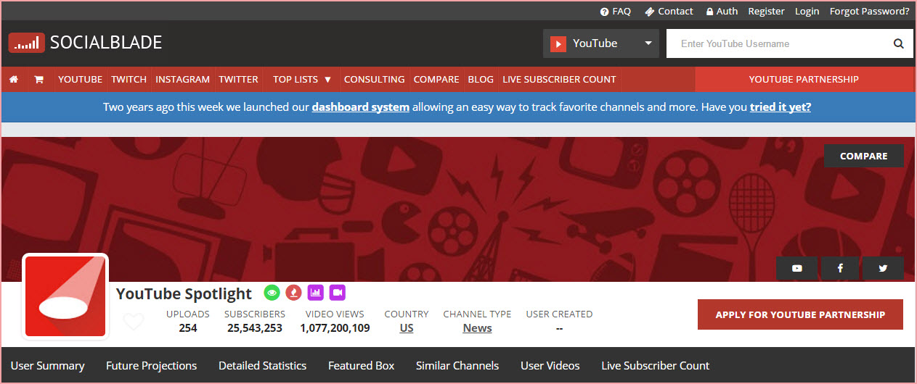
Post Your Facebook Live Videos to YouTube
1,077,200,109 video views monthly, according to Social Blade

Slide 17
Post Your Facebook Live Videos to YouTube
Strip the keywords down to absolute essentials
Add specific keywords to narrow the search queue
Strip away empty or weak words

Slide 18
Post Your Facebook Live Videos to YouTube

Slide 19
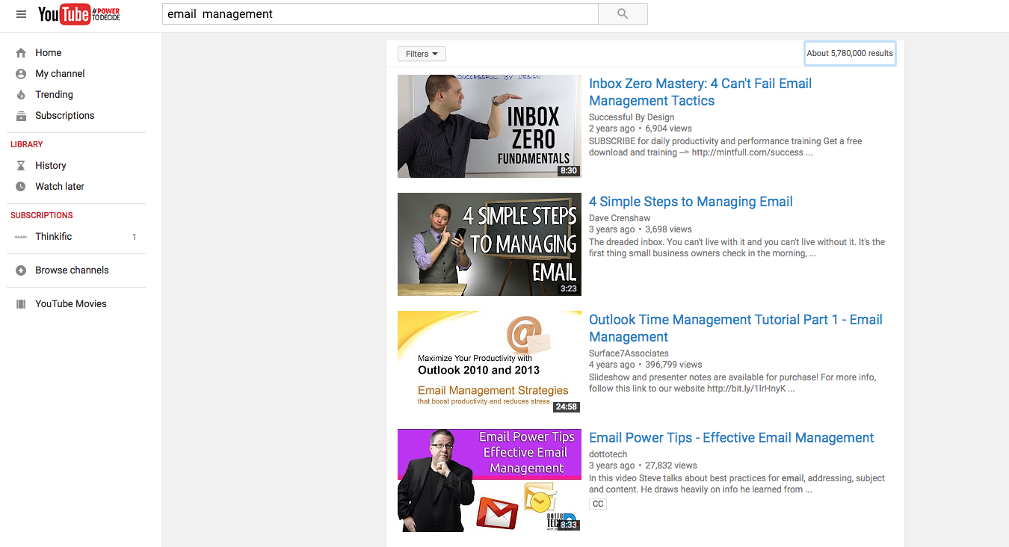
Post Your Facebook Live Videos to YouTube
People looking for specific “how to” information
People looking for instant entertainment

Slide 20
Step two: the best way to use it on your blog

Slide 21
The Best Way to Use it on Your Blog
Change the slant of the article to reflect feedback you got during or after the event
Split it into more than one keyword-specific article
Use it to promote your next Facebook Live appearance
And you can use actual keywords supplied by the people who watched the live video or its replay.

Slide 22
The Best Way to Use it on Your Blog
Blog about Facebook Live. Leslie Samuel got over 1.01k shares on his blog article: 246 Facebook Live Video: What Bloggers Need to Know
Keep an eye on your blog comments to see if your audience is asking questions that provide natural opportunities to write Facebook Live blog posts.

Slide 23
The Best Way to Use it on Your Blog
A bonus to doing this:
“If you embed the Facebook video onto a blog post, and a reader watches and Likes the video, they "bump" the video back into the news feed of their followers, potentially giving it greater visibility.”
Consider taking your videos from other platforms and uploading them to Facebook, and then embedding that post into your articles.

Slide 24
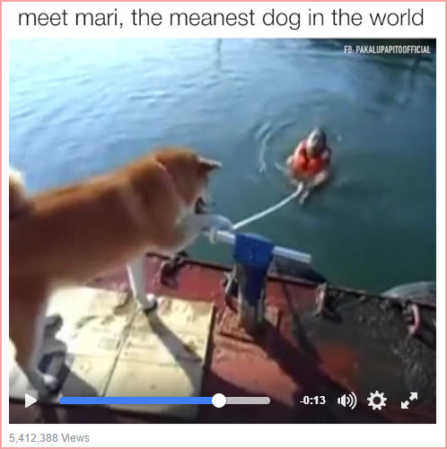
The Best Way to Use it on Your Blog
Download your Facebook Live video and post supporting photos to Instagram, as Marutaro did with his video of “Mari, the meanest dog in the World”.

Slide 25
The Best Way to Use it on Your Blog
Transcribe the audio portion of the FB live; then customize the transcription to fit into a blog post format by adding subheads, turning sections into bullet lists and so forth.
And be sure to use screenshots taken directly from your Facebook Live video, to illustrate your blog post!

Slide 26
Step three: transform it to audio

Slide 27
Transform it to Audio
Strip out the audio and use it for a podcast episode.
Click on the time stamp
Select “normal quality” (NOT HD)
Complete the process online using Audio-extractor.net
(Personally not tried this but …. It’s on the list)

Slide 28
Transform it to Audio
Don’t just randomly create podcast episodes. Plan them, so you can build a focused podcast series and create consistency to your topic or theme.

Slide 29
Step four: turn facebook live videos into a book

Slide 30
Turn Facebook Live Videos into a Book
Transcribing your video and saving screenshots from a themed collection of Facebook Live videos and then revise and edit your content to create an ebook/lead magnet.
This works best if you plan the book outline first; then plan your video segments so they will seamlessly fit into your plan.

Slide 31
Turn Facebook Live Videos into a Book
You will be gaining feedback to your live segments as you go, so that you know without having to lift a finger in doing research.
What people really think of what you are teaching … while you are teaching it
Which questions your teaching instantly brings up, or what objections they make
What they are most concerned about, and what your live words trigger
What they ignore
What they want more of
Important to know who you are trying to target with this.

Slide 32
Step five: get as many people to see the video as possible

Slide 33
Get As Many People to See the Video as Possible
Give your video to the person who was in it with you, if you created your Facebook Live video with a partner and get them to share it.
Create graphics for the video and share these with a link to your video on Instagram, Pinterest and Twitter.
And one really exciting use for your recorded Facebook Live video—that will really increase its reach—is as a Facebook ad. Facebook loves videos and its loves Facebook video ads – Winner!

Slide 34
Get As Many People to See the Video as Possible
Ask questions of your viewers – the easiest way and the way which generates engagement is to run comparison choices such as:
Video or PDF?
Stock Photos or Take Your Own?
Kindle for a prize or Amazon gift card?
Do name shout outs.

Slide 35
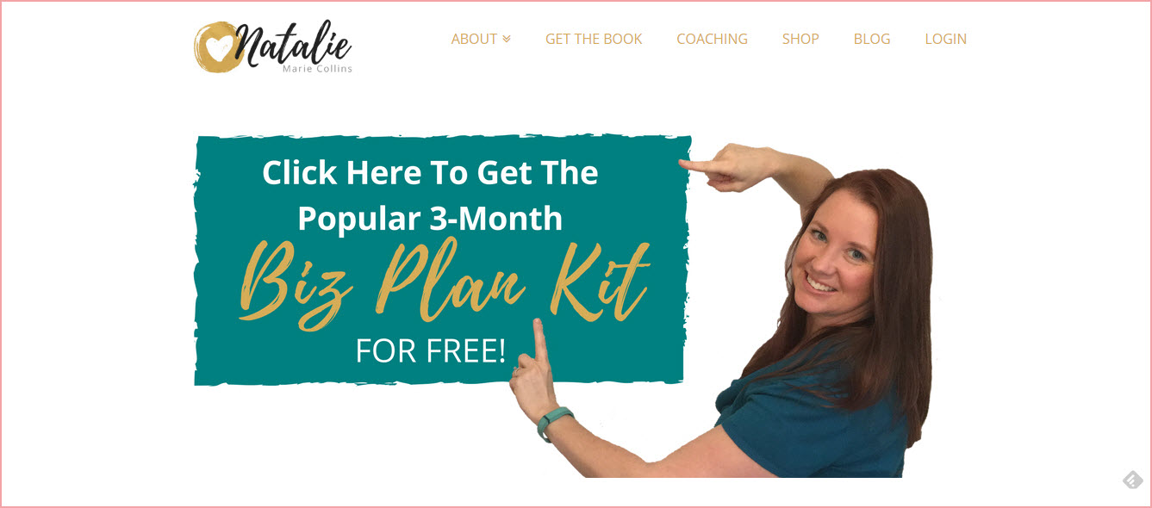
Get As Many People to See the Video as Possible
Select or upload your Live Video recording, enter the URL you want the ad to send people to, and set it as an Ongoing Ad.

Slide 36
Get As Many People to See the Video as Possible
Always be on the lookout for Facebook Live video topics … and opportunities to share it.
Announce your video to people, the morning you are planning to create it.
And again at hourly intervals on Twitter; at least once more on Facebook.
Let them know “I’ll be live at 2 p.m. today. Join me there to discuss [your topic]”.

Slide 37
Get As Many People to See the Video as Possible
Post again in your social networks when you are just about to go live.
And share the recording on your other social networks too.
Revisit your past Facebook Live recordings. Keep them in circulation.

Slide 38
Get As Many People to See the Video as Possible
But what’s the best way to leverage your Facebook Live videos?
You’ll never know … until you actually take action, begin making them and trying these strategies out.
Happy live streaming!

Slide 39
Questions?
Support: Work Books / Guides all in Thinkific to help you and now a challenge…

Slide 40
The Challenge!
Let’s Discuss….
A post for 7 days
A post for 14 days
What do you want it to do for you?
9 Objectives of Social Media

